Slide 1
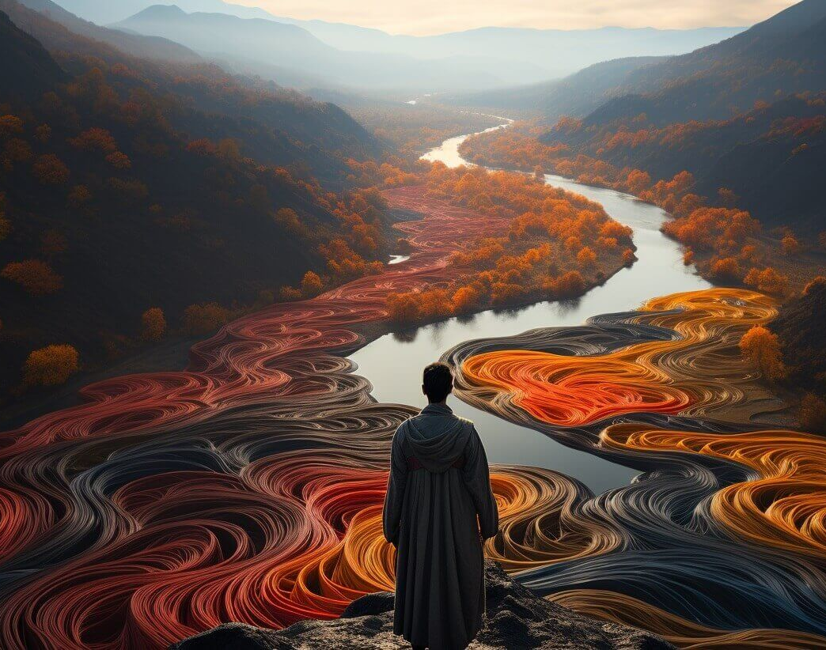
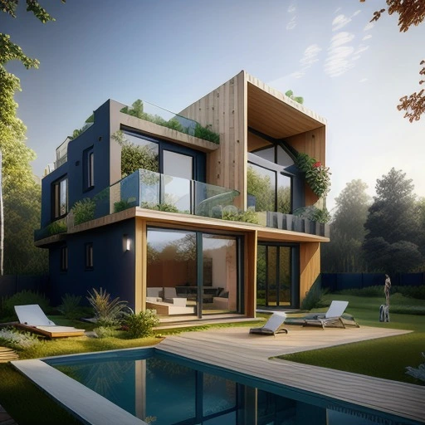
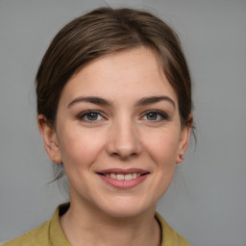
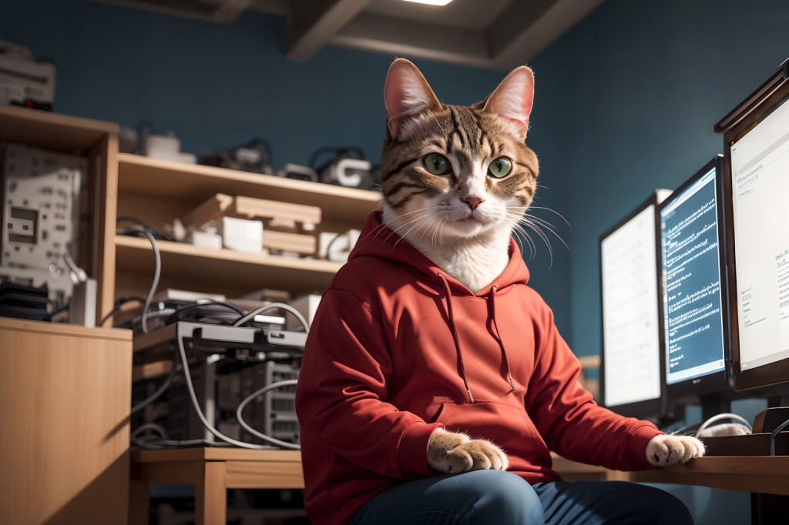
Have you recently been tricked by AI-generated content?

Slide 2
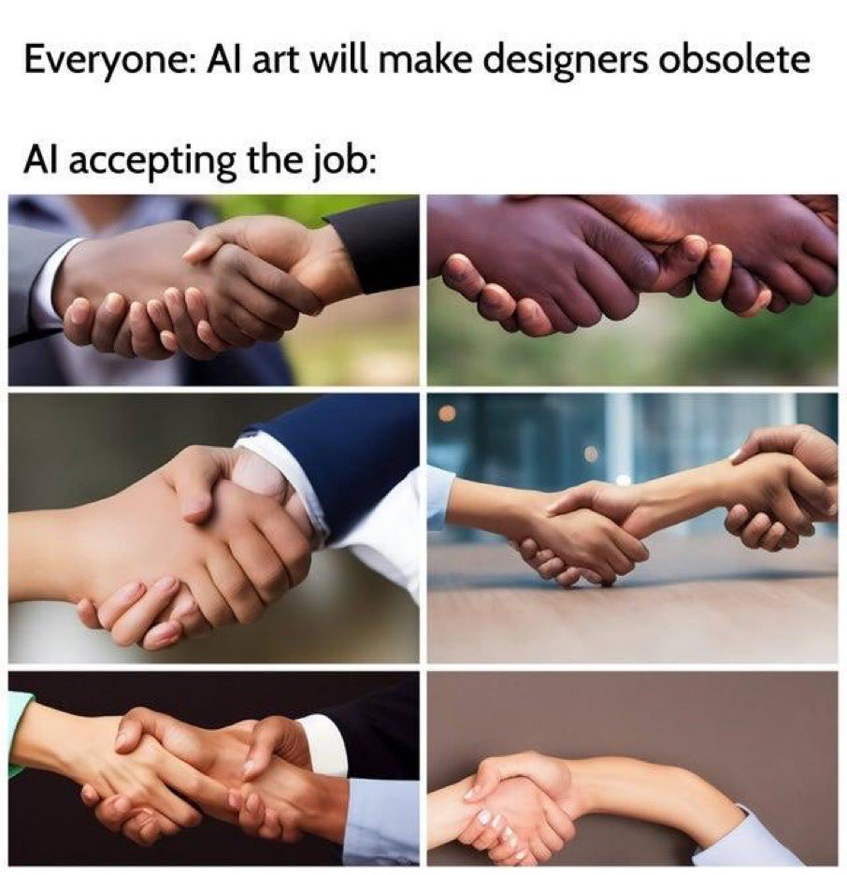
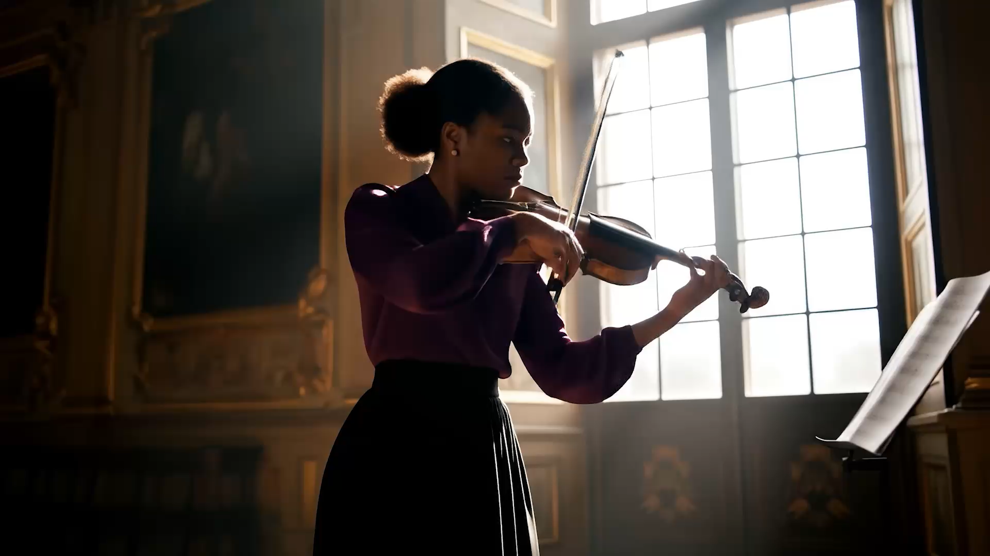
AI-Generated Content Improvements
2022-2025
Veo 3 (May 2025)

Slide 3
Detecting AI-Generated Images
Binary Classification: Real or Fake?

Slide 4
Data

Slide 5
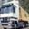
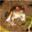
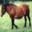
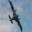

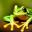
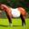

Dataset
Real (CIFAR10)
Source: Kaggle (CIFAKE Dataset)
Distribution: 120,000 images
50% from CIFAR-10
50% generated using Stable Diffusion on CIFAR-10
Fake (Stable Diffusion)

Slide 6
Model Architecture

Slide 7
Model Architecture
Base Model
Optimizer
ResNet-18 trained from random weights
Adam
Binary Cross Entropy
Sigmoid (within Loss Function)
Loss Function
Activation Function
Early Stopping (patience = 3)
Data Augmentation
Regularization

Slide 8
Performance

Slide 9
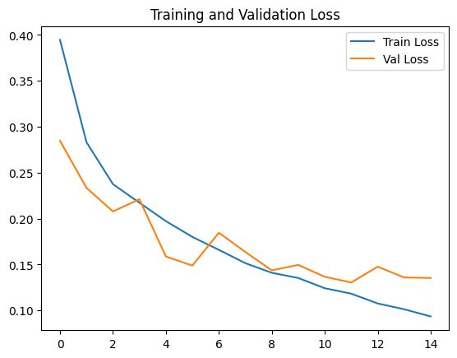
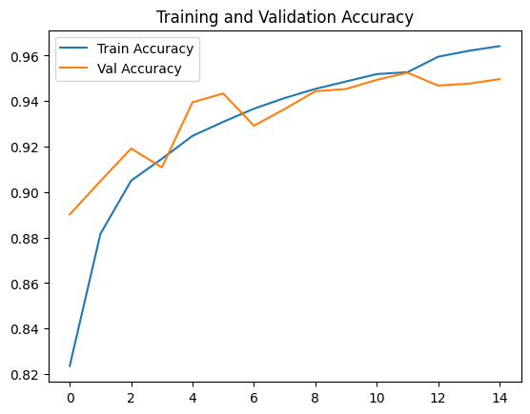
Performance
 | Train |  | Val |  | Test
(Lr, Batch Size) | Loss | Acc | Loss | Acc | Acc | Recall | Precision | F1 Score
(0.0005, 16) | 0.1183 | 95.27% | 0.1305 | 95.25% | 94.87% | 96.06% | 93.78% | 94.91%

Slide 10
Interpretation

Slide 11
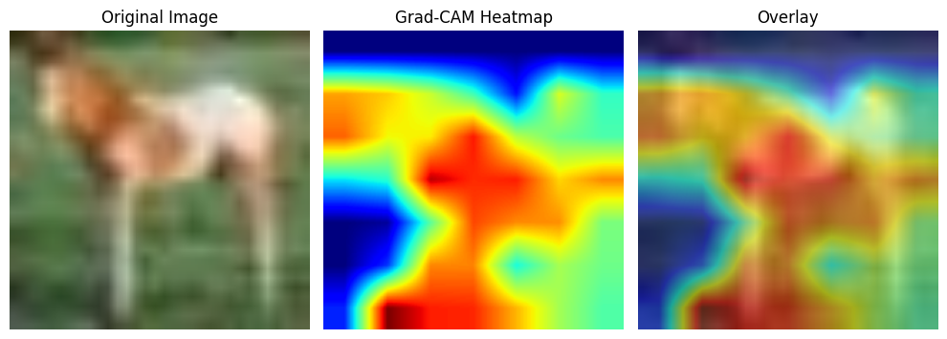
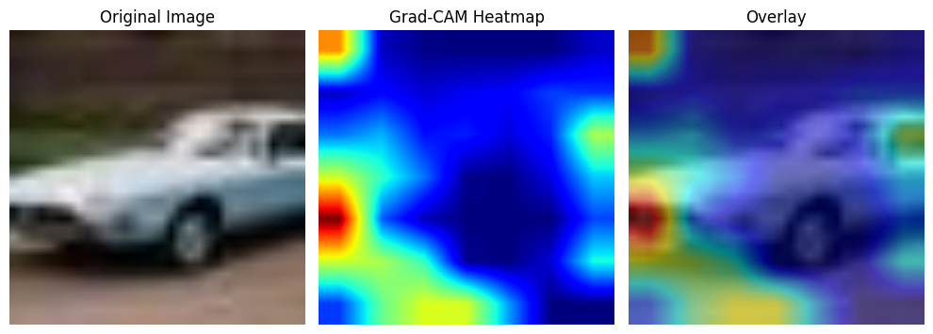
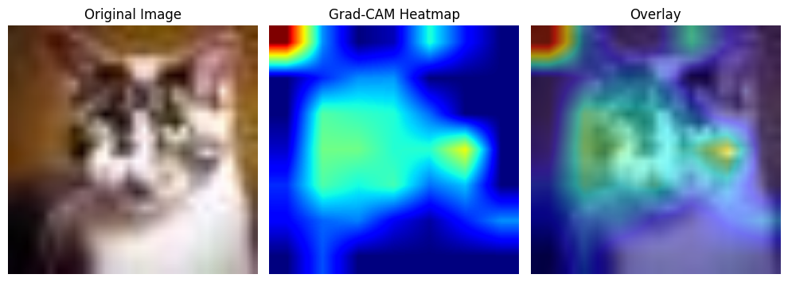
Grad-CAM on Real Image
Grad-CAM on Synthetic Image
Grad-CAM on Synthetic Image

Slide 12
Comparison Against ChatGPT

Slide 13
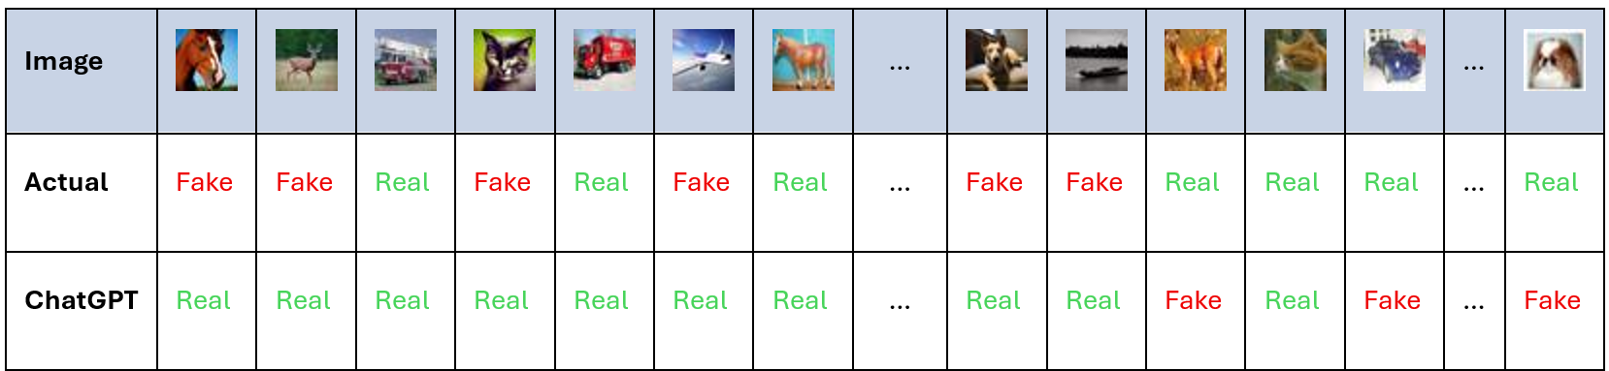
ChatGPT Performance on Sample Set
Multiple independent chats were opened with ChatGPT to test its performance on a sample of 10 fake and 10 real images in random order:
Some predicted all images to be AI-generated
Some predicted all images to be not AI-generated
Some had a mix of both but overall, very low accuracy as seen with the following sample of 20 images
Notes:
Update: added slide

Slide 14
Limitations & Improvements

Slide 15
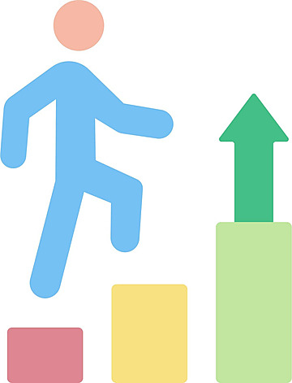
Limitation and Improvement
Limitation: Does not generalize well to other AI-generated images we see everyday.
Improvement: Increase the diversity of image sizes/resolutions and include images from other image generation methods.

Slide 16
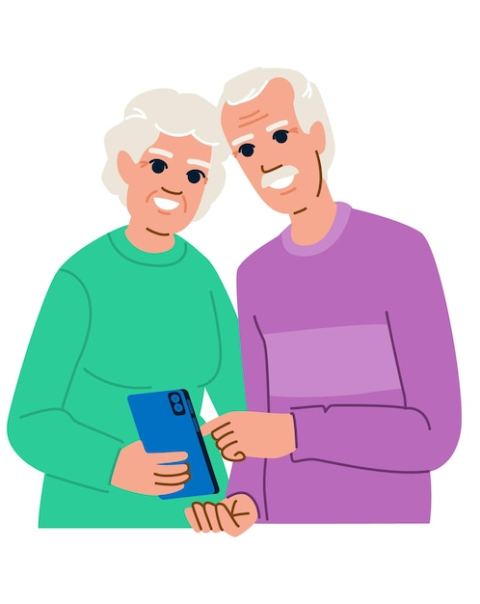
Final Takeaway:
Stop making fun of your parents for falling for fake Facebook and WhatsApp posts, because we are already on the same track falling for AI content.

Slide 17
Appendix
Notes:
Mention domain shift.

Slide 18
Stable Diffusion and Model Hierarchy
Stable Diffusion
Latent Diffusion
creates highly realistic images from just a text prompt
Diffusion but in a compressed space (instead of pixel space)
Diffusion
Generative
create images, text, etc.
add noise then reverse the process to generate new realistic images.

Slide 19
Performance
 | Train |  | Val |  | Test
(Lr, Batch Size) | Loss | Acc | Loss | Acc | Acc | Recall | Precision | F1 Score
(0.001, 16) | 0.18 | 93% | 0.17 | 93% | 94% | 95% | 93% | 94%
(0.001, 32) | 0.14 | 94% | 0.15 | 94% | 94% | 94% | 94% | 94%
(0.0005, 16) | 0.12 | 95% | 0.13 | 95% | 95% | 96% | 94% | 95%
(0.0005, 32) | 0.11 | 96% | 0.12 | 95% | 95% | 95% | 95% | 95%
(0.0001, 16) | 0.09 | 97% | 0.16 | 94% | 94% | 94% | 94% | 94%
(0.0001, 32) | 0.15 | 94% | 0.18 | 93% | 94% | 94% | 93% | 93%

